Slide 1
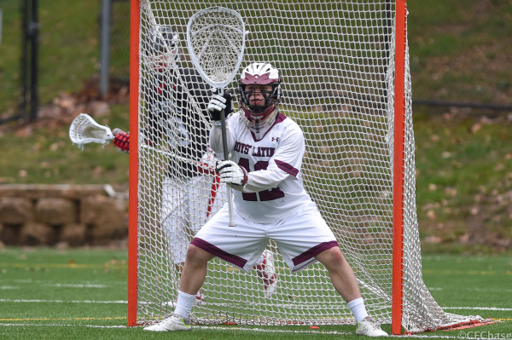
Damon Wilson
Email: damon@laxgoalierat.com
School: Montgomery High School, Class of ’99
Year: Sophomore
Position: Goalie
Club Team: Santa Rosa Lacrosse Club
Height: 5’8″
Weight: 165 lbs
GPA: 4.0 / SAT: 1350
Other Sports: Varsity Wresting, Varsity Soccer
Awards: 2-time All-American, 4-time All USA West Team
Camps Attended: Coach Bill Pilat Goalie School
Upcoming Events: Lake Tahoe Tournament June 23rd
Coach: Coach Name
Coach Email: Coach@coach.com

